Slide 1
Resume IQ
AI Resume Analyzer and Job Recommendation
Major Project Presentation
Submitted by: Khushpreet Kaur | Roll No.: 2300733
B.Tech. – Computer Science Engineering
Solitaire Infosys, Patiala • Bhai Gurdas Institute of Engineering & Technology

Slide 2
Project Overview
A simple career-support tool for students and job seekers
Resume IQ is a web-based resume analysis and job recommendation platform.
Users upload a resume in a supported format such as PDF, DOCX or TXT.
The application evaluates resume information and presents a score out of 100.
It detects skills, identifies suitable job roles and displays match percentages.
It also provides improvement suggestions and links to external job platforms.
RESUME IQ | AI Resume Analyzer and Job Recommendation 02

Slide 3
Objectives of Resume IQ
Resume Score
Give users a quick score out of 100 based on configured resume parameters.
Skill Detection
Identify technical skills already present in the resume.
Job Matching
Compare detected skills with supported job roles and show match percentages.
Apply Links
Guide users to platforms such as LinkedIn and Naukri to explore vacancies.
Improvement Tips
Suggest relevant skills and ways to improve clarity and impact.
Privacy-minded Handling
Limit file handling to the analysis workflow and use safe upload practices.
RESUME IQ | AI Resume Analyzer and Job Recommendation 03

Slide 4
Technologies Used
Frontend builds the interface; backend handles requests and processing
HTML
Defines the structure: headings, navigation, upload form, buttons, cards and content sections.
CSS
Controls layout, spacing, typography, responsive behavior, rounded cards and navy-blue/white styling.
JavaScript
Adds interaction, handles user actions and coordinates requests from the browser to the backend.
Node.js + Express.js
Node.js runs server-side JavaScript; Express organizes API routes, middleware, upload handling and responses.
RESUME IQ | AI Resume Analyzer and Job Recommendation 04

Slide 5
How It Works
Three main stages from upload to application
01 UPLOAD
The user selects or drags in a resume file and can choose experience level and preferred location.
02 ANALYZE
The system processes the resume, identifies relevant information and calculates a score out of 100.
03 APPLY
The user reviews matching roles, match percentages and external job links, then considers improvement tips.
RESUME IQ | AI Resume Analyzer and Job Recommendation 05

Slide 6
Resume Scoring & Job Matching
Resume Score (0–100)
The report describes evaluation dimensions such as contact information, section completeness, relevant skills, impact of achievements, and document length/readability. The score helps users quickly review their resume.
Role Match & Recommendations
Detected skills are compared with supported job-role requirements. Example roles shown in the interface include Full Stack Developer and MERN Stack Developer, with match percentages.
Results are guidance, not a guarantee of selection.
Users should check each vacancy’s requirements before applying.
RESUME IQ | AI Resume Analyzer and Job Recommendation 06

Slide 7
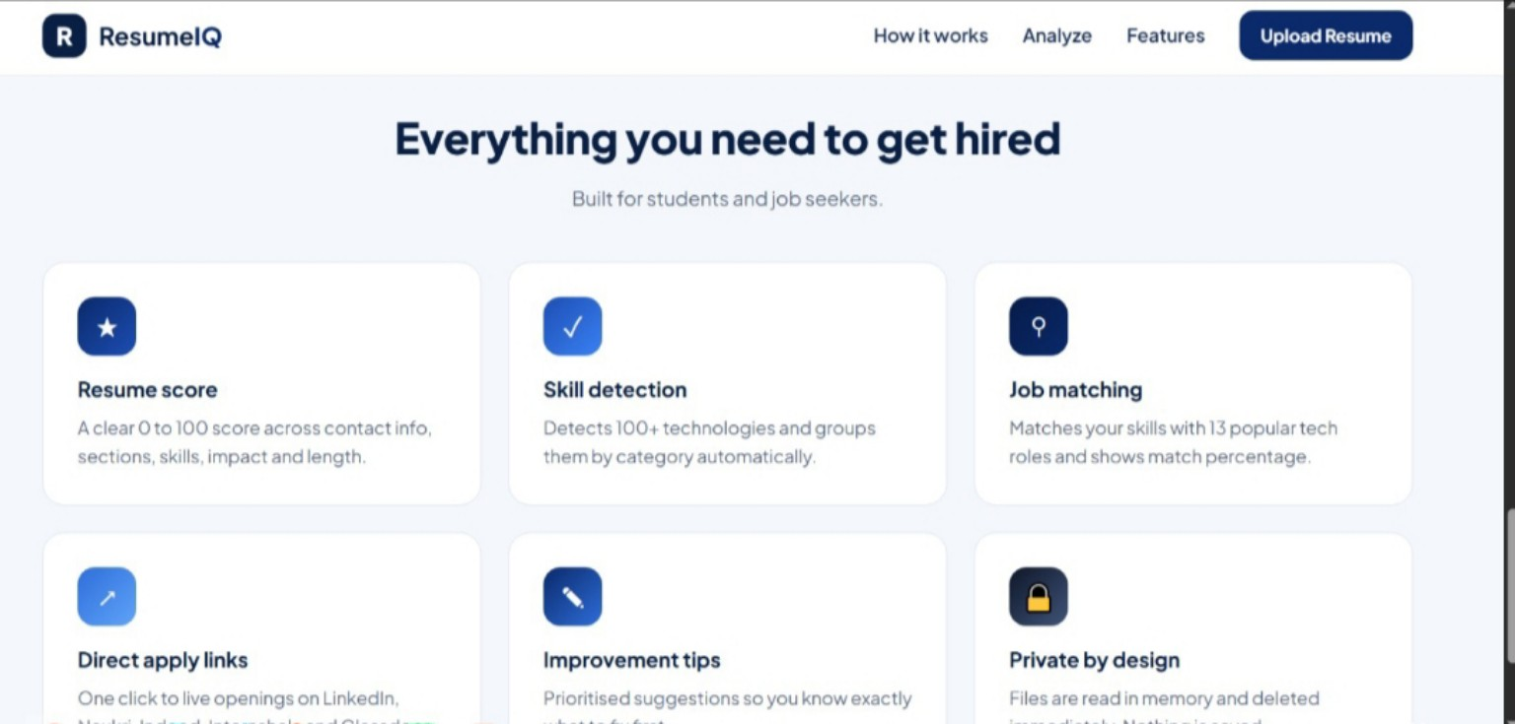
Screenshot 1 — Feature Cards
Website screenshot and what it demonstrates
Description
The feature section gives visitors a quick summary of the main capabilities available in Resume IQ.
Resume score: explains that the score is based on multiple resume parameters.
Skill detection: identifies technologies and groups them by category.
Job matching, apply links, improvement tips and privacy are presented as separate features.
RESUME IQ | AI Resume Analyzer and Job Recommendation 07

Slide 8
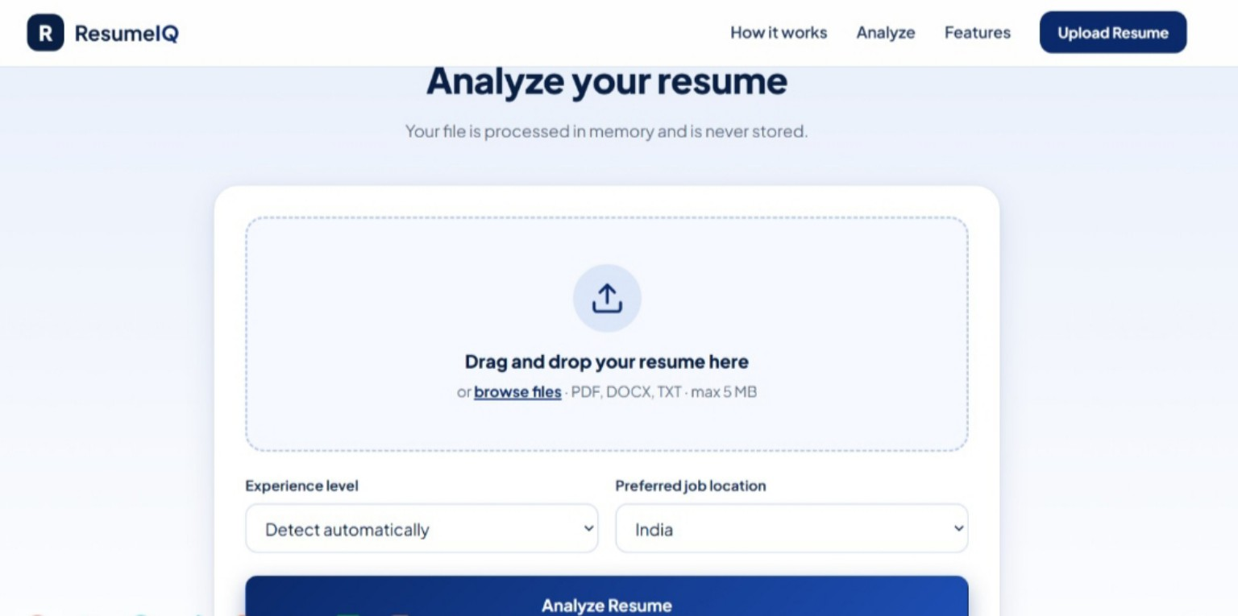
Screenshot 2 — Analyze Your Resume
Website screenshot and what it demonstrates
Description
This screen is the main entry point for submitting a resume for analysis.
The upload area supports drag-and-drop or browsing for a file.
Visible formats are PDF, DOCX and TXT, with a displayed maximum size of 5 MB.
Users can choose experience level and preferred job location before selecting Analyze Resume.
RESUME IQ | AI Resume Analyzer and Job Recommendation 08

Slide 9
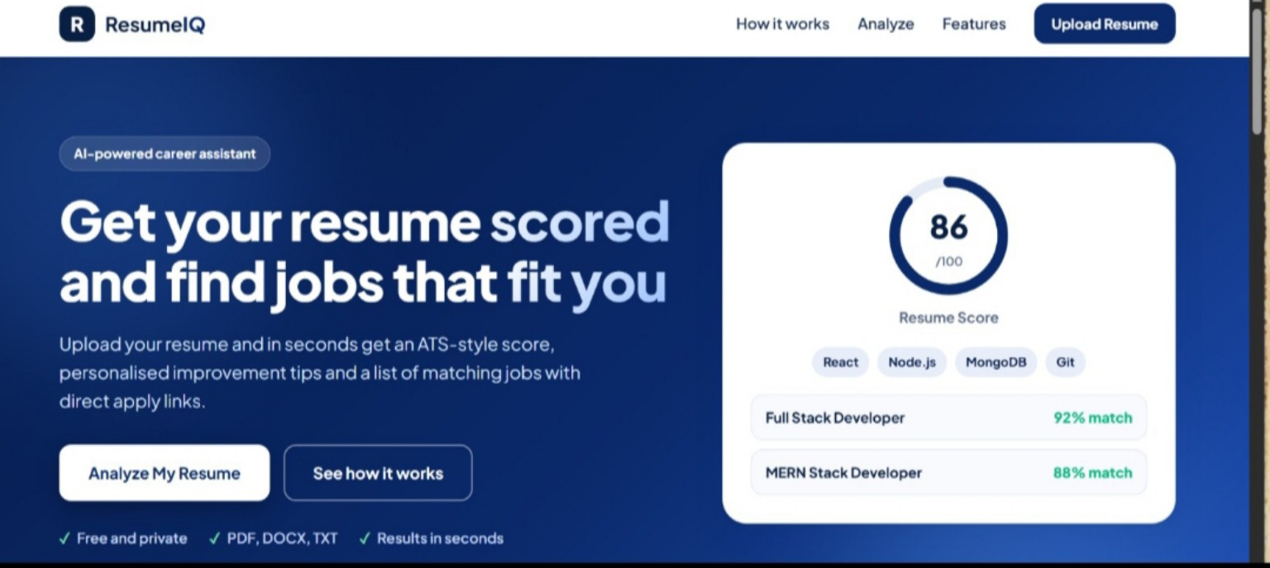
Screenshot 3 — Homepage & Example Results
Website screenshot and what it demonstrates
Description
The homepage introduces the project as an AI-powered career assistant and makes the primary action easy to find.
The “Analyze My Resume” button directs users toward the upload and analysis workflow.
A sample score of 86/100 illustrates how a result may be presented.
Example job cards show Full Stack Developer and MERN Stack Developer match percentages.
RESUME IQ | AI Resume Analyzer and Job Recommendation 09

Slide 10
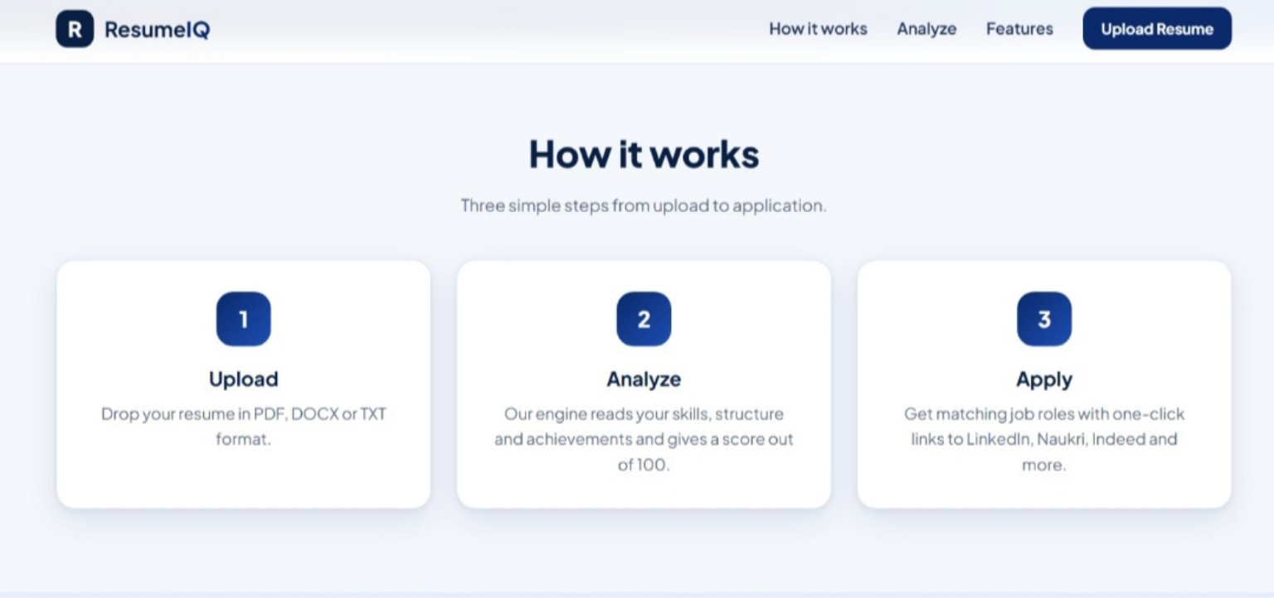
Screenshot 4 — How Resume IQ Works
Website screenshot and what it demonstrates
Description
The “How it works” section explains the end-to-end process in three clear steps.
Upload: provide a resume in a supported file format.
Analyze: the engine reads skills, structure and achievements to calculate a score.
Apply: explore matching roles through links to LinkedIn, Naukri, Indeed and other platforms.
RESUME IQ | AI Resume Analyzer and Job Recommendation 10

Slide 11
Security, Privacy & Limitations
Safe File Handling
Validate file type and size, handle unreadable documents gracefully, avoid unnecessary file retention and ensure temporary files are deleted according to the actual implementation.
Important Limitations
The quality of analysis depends on the document’s readability and the implemented rules. A score cannot fully represent a candidate’s potential, and job listings are controlled by external platforms.
The privacy and deletion statements should be verified against the deployed implementation.
Job recommendations should be treated as guidance, not a guarantee of employment.
RESUME IQ | AI Resume Analyzer and Job Recommendation 11

Slide 12
Future Scope
Compare resumes directly against a selected job description.
Provide clearer skill-gap analysis and more personalized recommendations.
Expand supported job roles and improve resume parsing.
Offer downloadable analysis reports and resume revision tracking.
Add multilingual support and further accessibility improvements.
RESUME IQ | AI Resume Analyzer and Job Recommendation 12

Slide 13
System Architecture & Component Interaction
How the browser, server and analysis workflow work together in Resume IQ
1. User Interface
2. Request & API Layer
3. Processing & Results
HTML structures pages and forms. CSS styles the interface. JavaScript handles actions such as selecting a file and starting analysis.
The browser sends the analysis request to the backend. Express.js organizes server routes and manages request–response flow.
Node.js runs server-side logic. Resume information is evaluated and the response is presented as a score, skills, role matches and tips.
Frontend ↔ Backend Communication
User-Facing Output
JavaScript coordinates browser-side actions and sends requests. The backend receives the request, processes it and returns a response for the interface to display.
The result screen turns analysis into understandable information: a score out of 100, detected skills, matching job roles and improvement suggestions.
RESUME IQ | AI Resume Analyzer and Job Recommendation 14

Slide 14
Frontend Technologies — Building the User Experience
The frontend is the part of Resume IQ that users see and interact with
HTML — Page Structure
CSS — Visual Presentation
Defines semantic page elements such as headings, navigation, upload form, buttons, cards and result sections. It gives content a clear hierarchy.
Controls colors, spacing, typography, alignment, card styling and responsive layouts. It keeps the interface consistent and readable across screen sizes.
JavaScript — Interaction
Responsive & Clear Interface
Responds to user actions, manages form behavior, coordinates the resume-analysis request and updates the page with returned information.
The combination of structure, styling and interaction supports an understandable upload flow and organized presentation of analysis results.
Together, these technologies separate content, appearance and behavior, making the interface easier to understand and maintain.
RESUME IQ | AI Resume Analyzer and Job Recommendation 15

Slide 15
Backend Technologies — Request Handling & Processing
Node.js and Express.js provide the server-side foundation described for Resume IQ
Node.js — Server Runtime
Express.js — Web Framework
Node.js allows JavaScript to run on the server. It receives browser requests and executes the server-side operations required by the application.
Express.js helps organize backend routes and middleware. It provides a structured way to receive requests, handle upload-related operations and send responses.
API Request–Response Cycle
Why This Separation Matters
The frontend initiates an operation, the backend receives the request, performs the required processing and returns a response that the browser can present.
Keeping interface responsibilities in the browser and request processing on the server creates a clearer application structure and makes individual parts easier to update.
RESUME IQ | AI Resume Analyzer and Job Recommendation 16

Slide 16
Resume Upload & Analysis Pipeline
A closer look at the documented journey from selecting a file to viewing a report
01 SELECT
02 CHECK
User chooses a resume file or drags it into the upload area. Supported formats shown are PDF, DOCX and TXT.
The upload interface displays supported file types and a maximum size of 5 MB. The request is then sent for analysis.
03 PROCESS
04 PRESENT
The application processes resume information and identifies relevant details such as skills, sections and achievements.
The result is shown as a score, detected skills, matching roles, match percentages and improvement guidance.
RESUME IQ | AI Resume Analyzer and Job Recommendation 17

Slide 17
Resume Evaluation — Understanding the Score
The score is a structured review aid, not a promise of selection
Contact Information
Section Completeness
Relevant Skills
Checks whether essential contact details are present and easy to locate.
Reviews whether important resume sections are included and organized.
Considers the technical skills identified in the resume.
Achievements & Impact
Length & Readability
Encourages clear descriptions of contributions and outcomes.
Considers document length and how easy the content is to read.
These are evaluation dimensions described in the original presentation. The final score depends on parameters configured in the application and should be interpreted as guidance.
RESUME IQ | AI Resume Analyzer and Job Recommendation 18

Slide 18
Skill Detection, Role Matching & Recommendations
Turning resume information into practical next steps
Skill Detection
Role Comparison
Match Percentage
The system identifies technical skills already present in the resume and groups technologies by category as shown in the feature description.
Detected skills are compared with the requirements associated with supported job roles.
The interface displays a percentage to help users compare their current skill profile with example roles.
Improvement Guidance
Explore Opportunities
Suggestions highlight relevant skills and ways to improve resume clarity and impact.
External links such as LinkedIn and Naukri help users continue their job search.
Example roles shown in the project include Full Stack Developer and MERN Stack Developer.
RESUME IQ | AI Resume Analyzer and Job Recommendation 19

Slide 19
Analysis Results — What the User Receives
The report organizes several kinds of feedback in one place
Resume Score
Detected Skills
Job Role Matches
A score out of 100 provides a quick summary of the resume evaluation.
A view of technical skills found in the submitted document.
Suggested roles with match percentages help users explore relevant directions.
Improvement Tips
Apply Links
Actionable guidance encourages clearer, more relevant resume content.
Links to external job platforms support the next step after reviewing results.
A sample score of 86/100 in the original presentation illustrates the result layout; it is an example, not a guaranteed outcome.
RESUME IQ | AI Resume Analyzer and Job Recommendation 20

Slide 20
Technical Summary & Key Takeaways
How the selected technologies contribute to the Resume IQ project
HTML
Structures website content and forms.
CSS
Defines layout, spacing, responsive behavior and visual consistency.
JavaScript
Adds browser interaction and coordinates requests.
Node.js
Runs the server-side JavaScript environment.
Express.js
Organizes API routes, middleware and request/response handling.
Together, the stack supports a complete flow: user input → server-side processing → structured resume feedback.
RESUME IQ | AI Resume Analyzer and Job Recommendation 21

Slide 21
Conclusion
Resume IQ brings resume assessment, skill detection, job matching and improvement guidance into one straightforward workflow.
It is designed to help students and job seekers understand their resume better and take the next step toward suitable opportunities.
Thank You

